Slide 1

Intelligent Project Management System for Undergraduate Students
Transforming undergraduate project management through AI-driven automation and intelligent decision-making
Project ID: R26-IT-095 | SLIIT Faculty of Computing
Supervisors: Prof. Samantha Rajapaksha, Mrs. Kaushika Kahatapitiya
Bandara N.D.M (IT22114662) • Lekamge R.L.M.D (IT22117014) • Kulathunga S.A.I.K • Rashmika R.M.D

Slide 2

Project Context & Research Motivation
Current Challenges
Research Gap
Undergraduate project management faces critical issues: random team allocation creates skill mismatches, poor topic feasibility leads to abandoned projects, manual planning causes delays, and lack of intelligent risk monitoring results in failures.
Existing tools lack integrated AI-driven automation for team formation, adaptive scheduling, predictive risk analysis, and quality assessment—creating an opportunity for intelligent project management.
SDG Alignment: Supports Quality Education (SDG 4) through intelligent automation and adaptive learning.
Impact: Student stress, unequal workloads, project delays, and compromised academic outcomes.

Slide 3

Target Users & Beneficiaries
Undergraduate Students
Supervisors
Final-year students managing capstone projects requiring intelligent guidance and adaptive support throughout their research journey.
Faculty members overseeing multiple student projects who need automated quality assessment and real-time progress monitoring.
Research Coordinators
Academic Institutions
Academic administrators managing project allocation, resource distribution, and institutional quality assurance processes.
Universities seeking to improve project success rates, reduce supervisor workload, and enhance educational outcomes through AI.

Slide 4
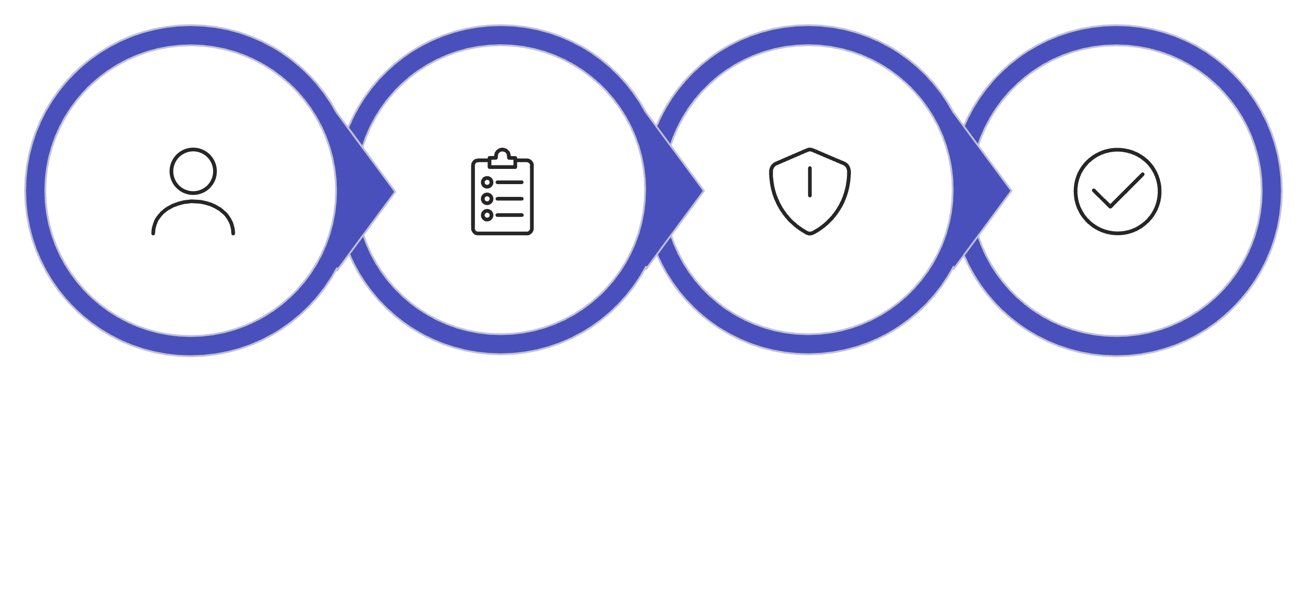
System Architecture Overview
IPMS integrates four intelligent components into a unified ecosystem, enabling end-to-end project management from team formation to completion.
Team Formation
Project Planning
Risk Monitoring
Quality Assessment

Slide 5
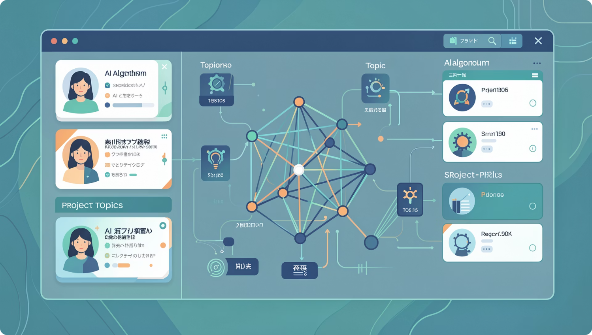
Component 1: Intelligent Team Formation & Topic Feasibility
Bandara N.D.M – IT22114662
Problem
Random team allocation creates skill mismatches, poor topic feasibility leads to project abandonment, and manual validation lacks predictive accuracy.
Solution Approach
Semantic profiling using SBERT embeddings
Multi-objective optimization with NSGA-II
Feasibility prediction via XGBoost classifier
Cold-start validation for new topics
Key Results
Explainable AI
Similarity threshold: Cosine ≥ 0.80
Prediction accuracy: F1 ≥ 0.82
Discrimination power: AUC-ROC ≥ 0.85
SHAP values provide interpretable feature importance, enabling supervisors to understand team matching rationale and feasibility predictions.

Slide 6
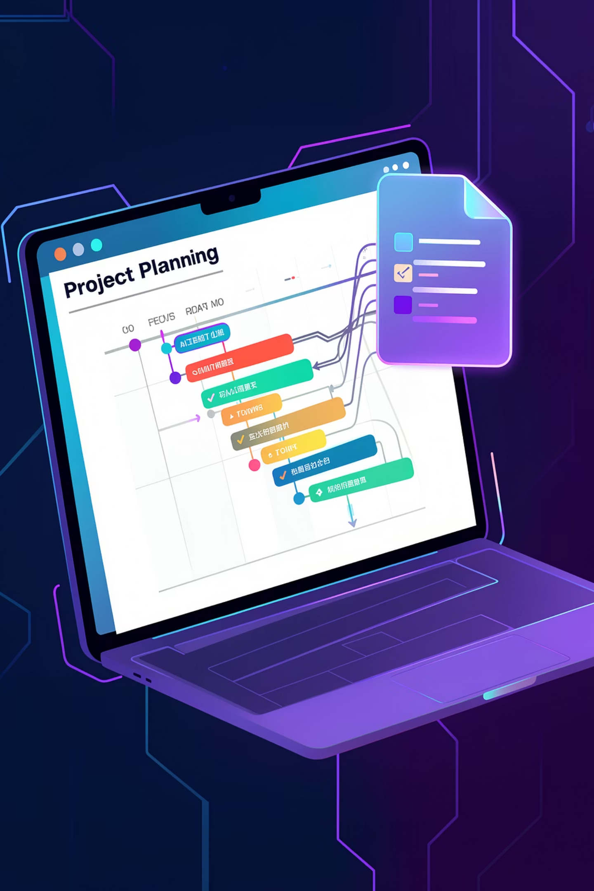




Component 2: Generative Project Planning & Adaptive Scheduling
Lekamge R.L.M.D – IT22117014
NLP Proposal Parsing
T5 Transformer extracts objectives, deliverables, and constraints
WBS Generation
Automatic work breakdown structure creation with task hierarchies
Gantt Scheduling
Visual timeline with dependencies and resource allocation
EDF Rescheduling
Earliest Deadline First algorithm adapts to delays in real-time
Technical Implementation
Adaptive Features
Transformer-based NLP achieves 85% extraction accuracy from unstructured proposal text, generating structured project plans automatically.
Real-time deadline optimization recalculates schedules when delays occur, minimizing cascading failures and maintaining project viability.

Slide 7
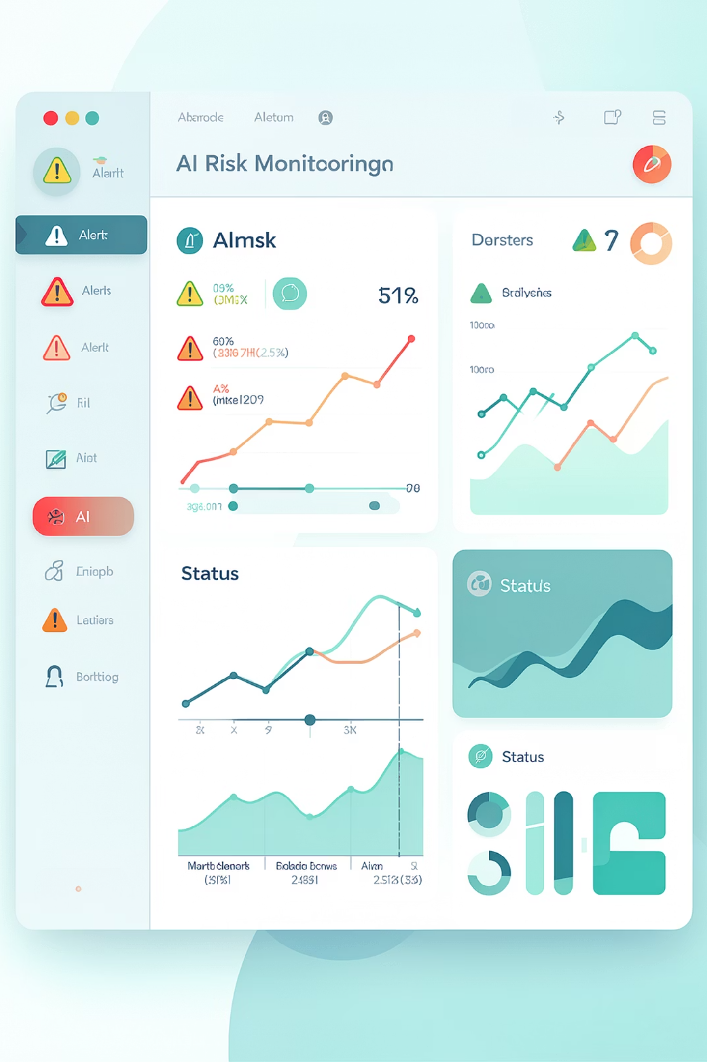
Component 3: Intelligent Risk Monitoring & Prediction
Kulathunga S.A.I.K
Risk Scoring Engine
Dashboard Monitoring
ML models analyze progress patterns, milestone completion rates, and behavioral indicators to assign risk scores
Real-time visualization of risk heatmaps, trend analysis, and comparative performance metrics
Early Warning Alerts
Proactive notifications to supervisors when risk thresholds exceed predefined levels
Key Contributions
Implemented predictive risk analytics that identifies struggling projects 3-4 weeks before traditional methods. Integrated real-time monitoring enables supervisors to intervene early, preventing project failures and reducing corrective workload.

Slide 8
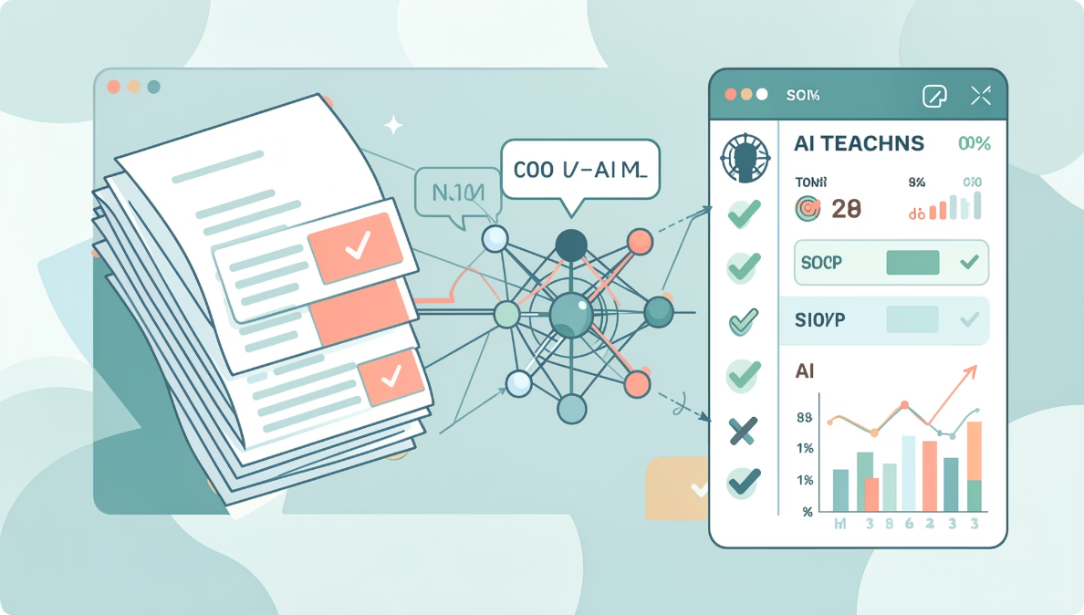
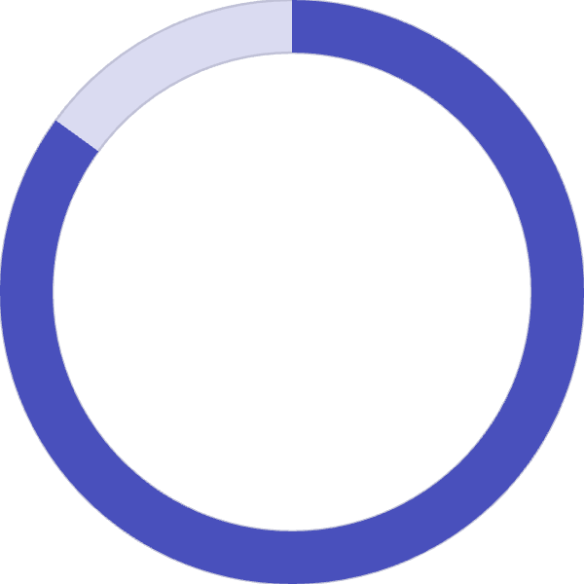

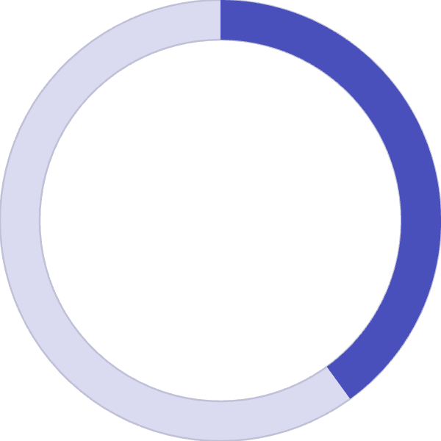
Component 4: Automated Quality Assessment & Adaptive Mentorship
Rashmika R.M.D
Semantic Grading Engine
Sentence-BERT embeddings enable semantic similarity analysis between expected and actual deliverables, while spaCy performs structural validation.
Adaptive Features
Knowledge gap detection identifies weak areas
Personalized resource recommendations
Automated feedback generation with explanations
Progress tracking with improvement suggestions
85%
92%
40%
Accuracy
Consistency
Time Saved
Semantic similarity matching
Grading reliability across submissions
Supervisor workload reduction

Slide 9

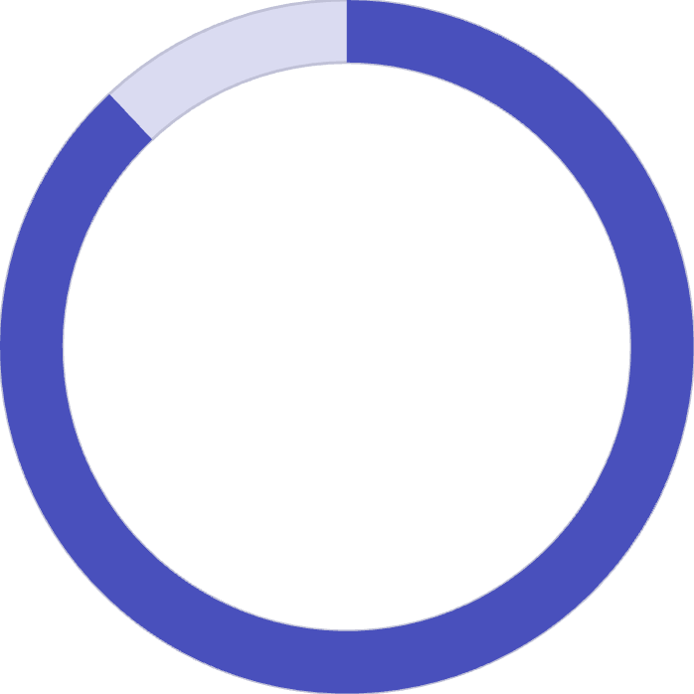
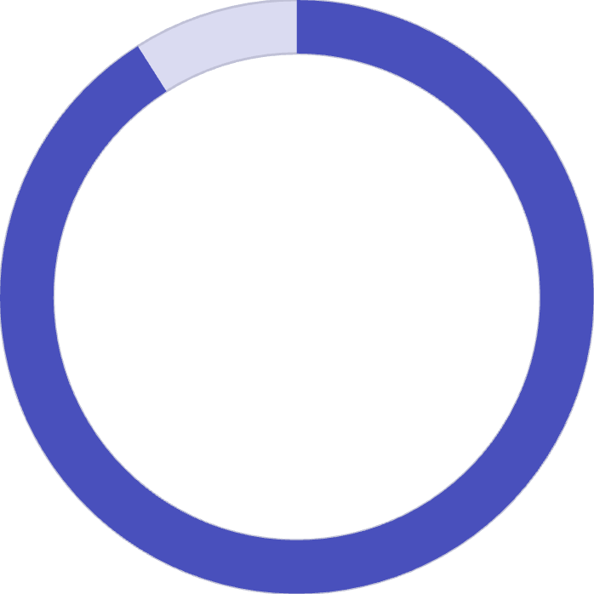
Validation & Commercialization
User Feedback Results
94%
88%
91%
Found Useful
Reduced Confusion
Improved Supervision
Students reported system improved project organization
Clear planning reduced initial project uncertainty
Better support through automated monitoring
Commercial Strategy
Target Market
Revenue Model
Future Roadmap
Sri Lankan universities, South Asian educational institutions, growing educational AI market
SaaS subscription with tiered pricing: Basic, Professional, Enterprise licensing options
Mobile app, real-time collaboration, AI copilots, voice assistants, expanded analytics

Slide 10



Research Impact & Future Directions
Educational Impact
Technical Innovation
Future Vision
Reduces project failure rates, improves student outcomes, supports Quality Education (SDG 4) through intelligent automation
First integrated system combining semantic profiling, adaptive scheduling, predictive risk, and automated assessment for academic projects
Expand to mobile platforms, integrate real-time collaboration, deploy AI copilots, add voice assistants for accessibility
Transforming undergraduate project management through artificial intelligence—enabling students to succeed, empowering supervisors to excel, and advancing educational quality through intelligent automation.
Thank you for your attention. Questions welcome.

